Slide 1
Enhancing Motorcycle Safety with Smart Helmet Technology
TEAM MEMBERS:
(102103209) SIDDHANT JAIN (Group Leader)
(102103232) AMANPREET SINGH
(102103359) SAKSHAM MUTNEJA
(102103364) SAMARTH THAKUR
(102283026) SHIVAM GUPTA
CPG No. 195
(MENTOR) - Dr. Shivani Sharma

Slide 2
PROBLEM STATEMENT and OBJECTIVES
The project aims to develop a smart helmet system for motorcycle riders, integrating various sensors and modules to enhance safety and convenience. Key objectives include detecting alcohol consumption, ensuring helmet usage, monitoring distances from the front vehicle, detecting accidents, and providing emergency communication capabilities.
Objectives:
Design and Develop Smart Helmet Prototype
Implement Sensor Integration and Control System
Enhance Safety and Preventive Measures
Enable Emergency Communication and Data Collection
Validate System Performance and User Feedback

Slide 3
PROJECT OVERVIEW
Alcohol Detection: Utilize an alcohol sensor to detect intoxication levels in the rider's breath. Prevent bike ignition if alcohol is detected.
Helmet Detection: Implement an IR sensor to verify helmet usage before allowing the bike to start.
Distance Monitoring: Incorporate an ultrasonic sensor to warn riders of unsafe distances from the front vehicle, reducing collision risks.
Accident Detection: Integrate an accelerometer to detect sudden impacts or falls, triggering emergency procedures.
Emergency Communication: Utilize GPS and GSM modules to send SMS alerts with the rider's location to predefined contacts during emergencies.
Video Recording: Include a camera module to record ride footage for analysis or evidence in case of accidents or violations.
Display and Audio Alerts: Provide real-time information and warnings to the rider via an LCD display, alarm, speaker, and mic.
Raspberry Pi Control: Employ Raspberry Pi to manage sensor data, system operations, and communication.

Slide 4
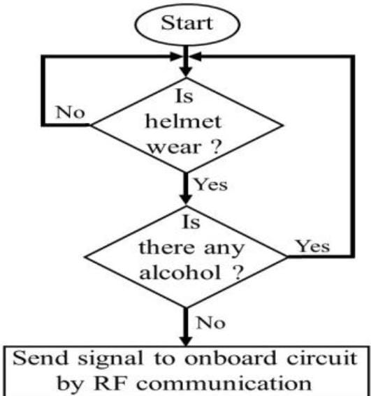
UML Diagrams

Slide 5
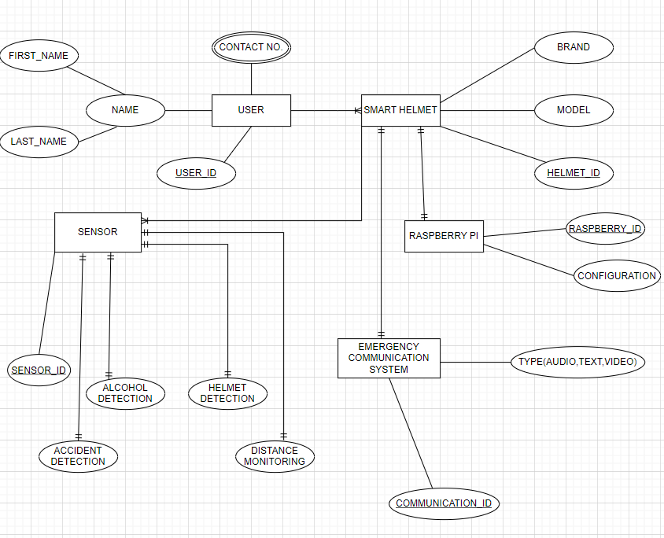
UML Diagrams

Slide 6
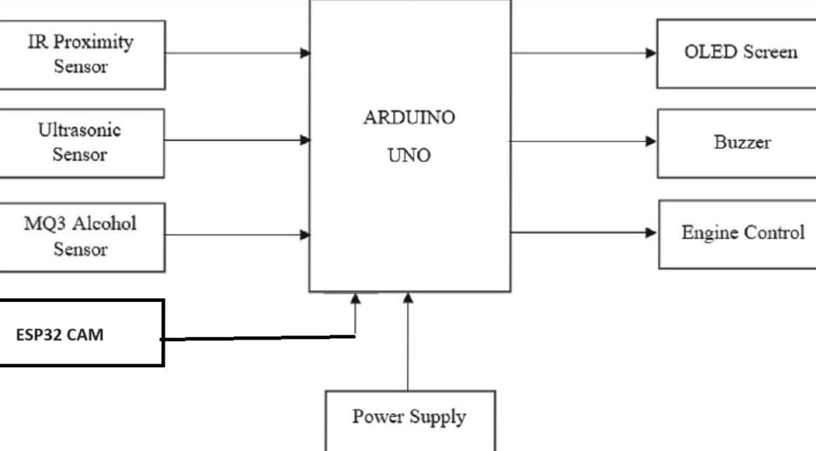
UML Diagrams

Slide 7
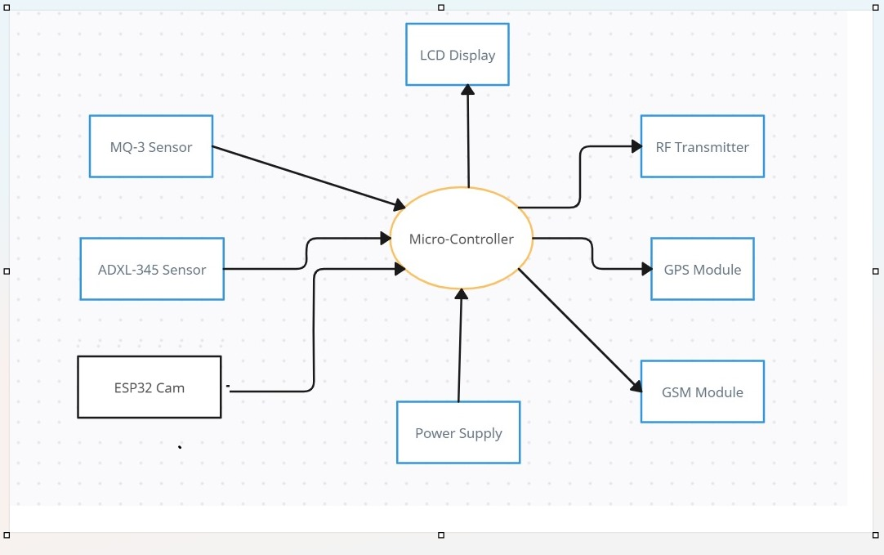
UML Diagrams

Slide 8
LITERATURE SURVEY
Shravya K., Mandapati Y., Keerthi D., Harika K., and Senapati R.
Smart helmet for safe driving
Budhathoki S., Nyaupane S., Chai S., Nath S.
Design of Smart Helmet using Microcontroller
Sireesha G., Jahnavi K., Anusha N., Baburay A.
Smart Helmet using IoT
Sekar S., Jaivenkatesh L., Kumar S., Kumar D., Jeevanantham N. T
IoT BASED SMART HELMET
Deekshitha K J, Pushpalatha S
IMPLEMENTATION OF SMART HELMET
Balgude P., Bhoite R., Baral S., Borate4 S.
Smart Helmet using IoT

Slide 9
Components/Platforms used
ESP32 Cam
ESP32 38 Pins
Ultrasonic Sensor
IR sensor
GSM Module SIM900 A
GPS Tracker
ADXL 345
MQ3 Alcohol Sensor
LCD Display I2C4
Jumper Wires
Breadboard
SD Card
Arduino IDE

Slide 10
Cost Analysis
The invoice details a comprehensive purchase of various electronic components and modules, totaling ₹2,255.00. It includes key items like a 16x2 Blue LCD Display with I2C, FT232 USB to TTL converter, and an ESP32 WROOM MCU Module with a camera, which are integral to embedded systems projects. The list also comprises multiple sensor modules, such as the MQ3 gas sensor, NEO-6M GPS module, and ultrasonic and IR sensors, along with essential accessories like jumper cables and a mini USB cable. Each item is taxed at an 18% IGST rate, with the individual prices and tax amounts meticulously listed, contributing to the overall cost. This detailed invoice highlights the investment in a range of components likely intended for a sophisticated electronics project, providing transparency and clarity in the expenditure breakdown.

Slide 11
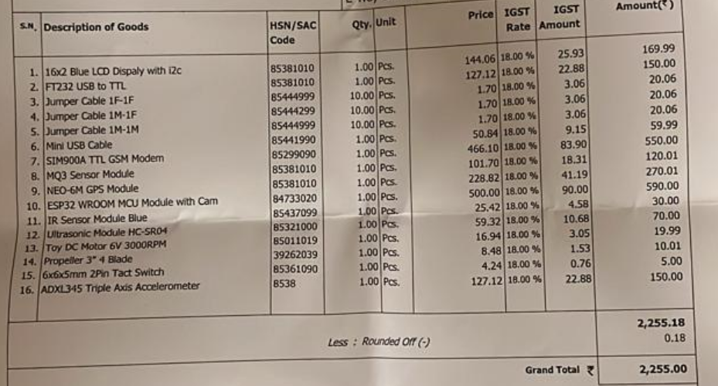
Cost Analysis

Slide 12
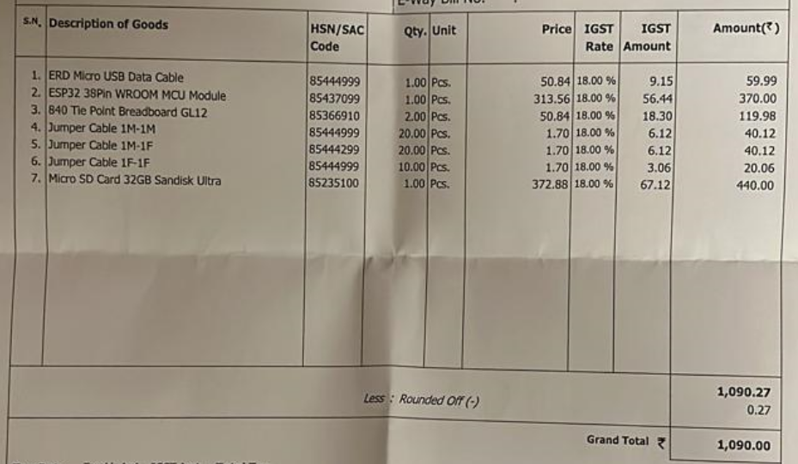
Cost Analysis

Slide 13
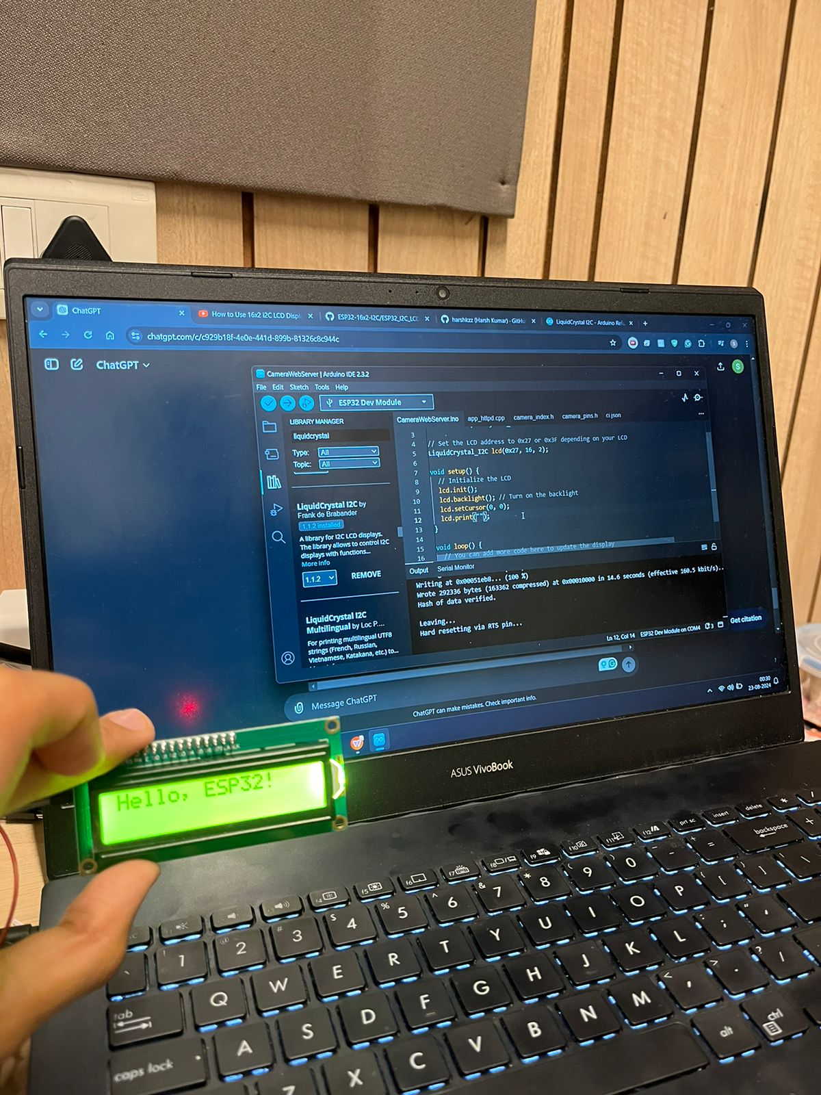
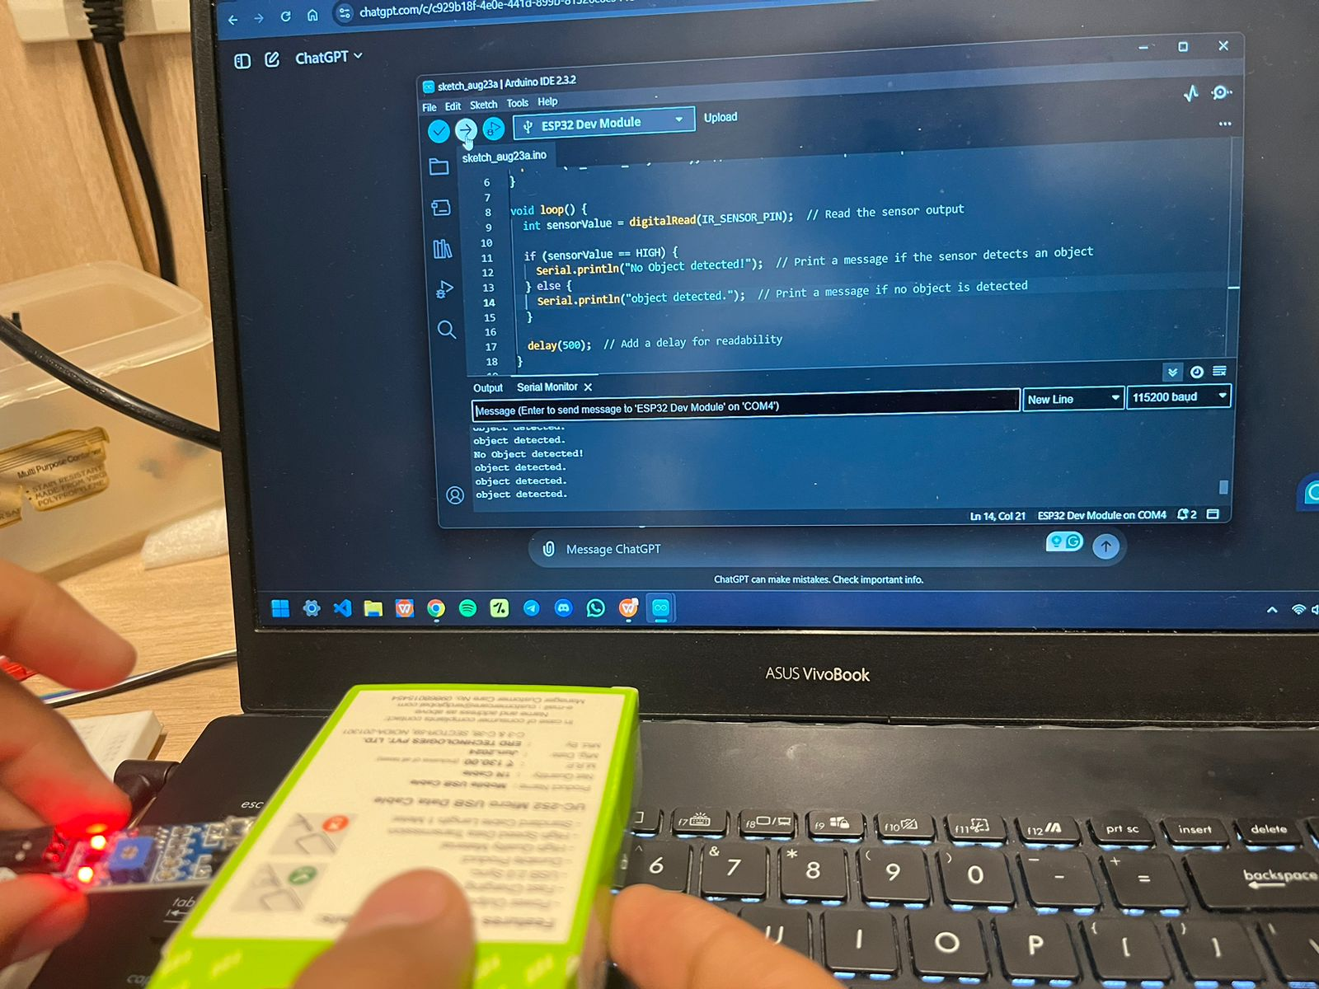
Current progress
Testing completed of individual components

Slide 14
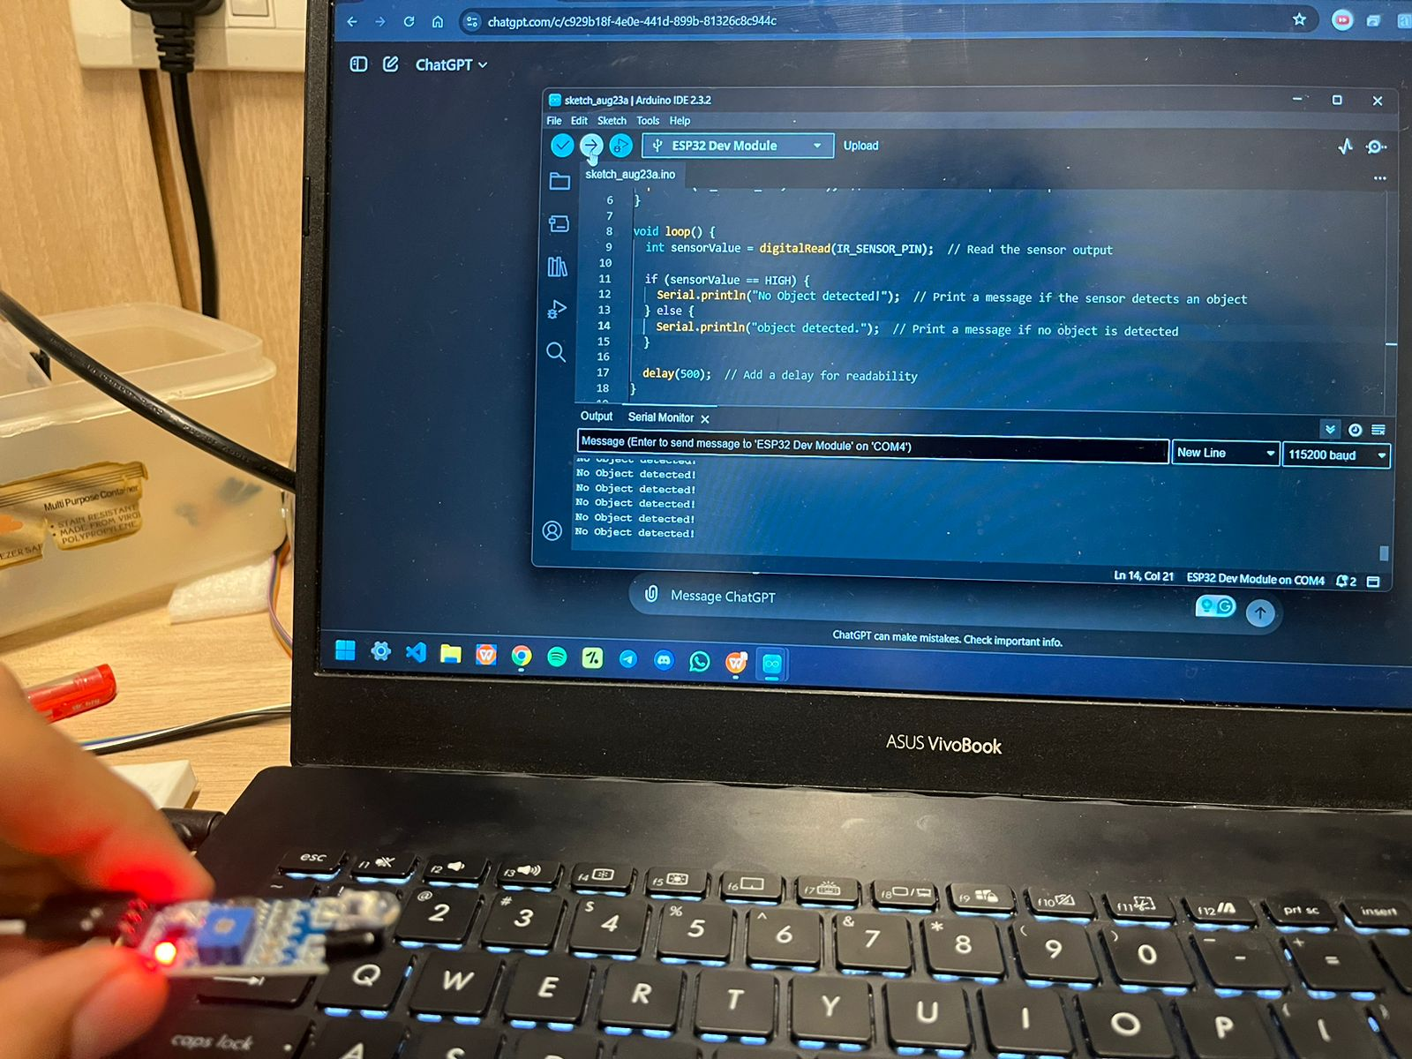
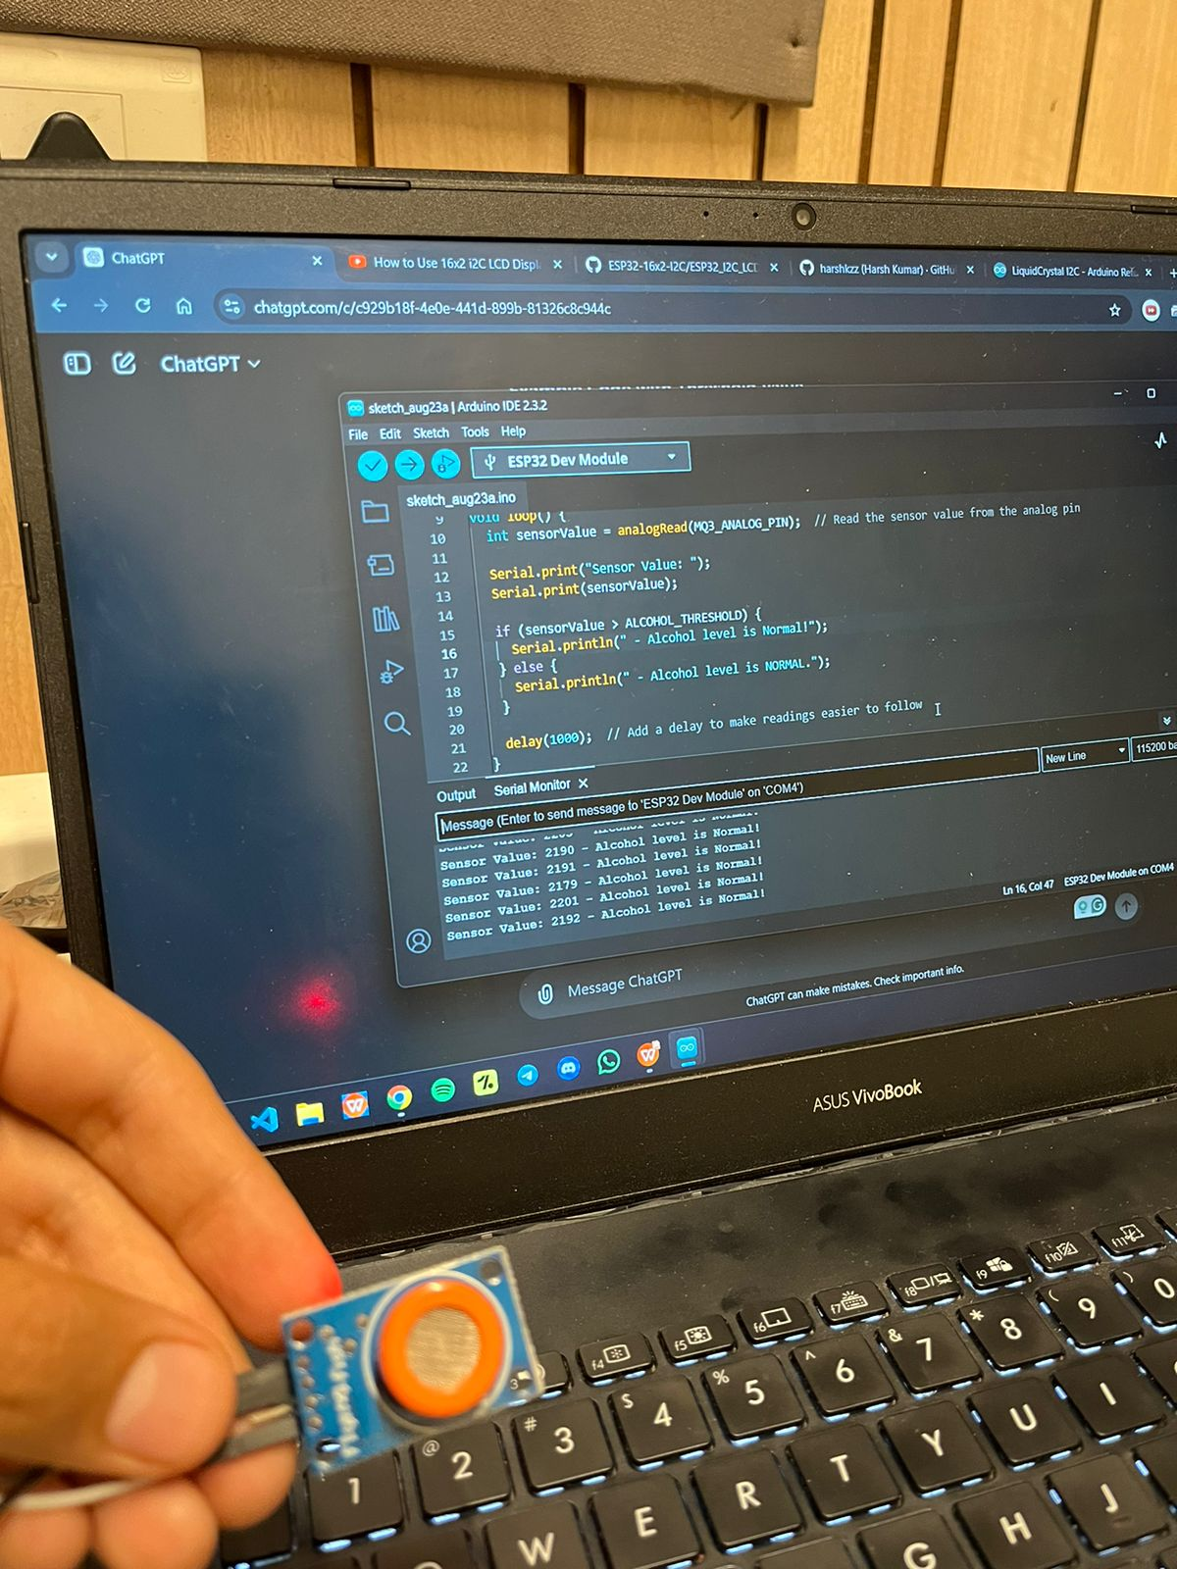
Current progress
Testing completed of individual components

Slide 15
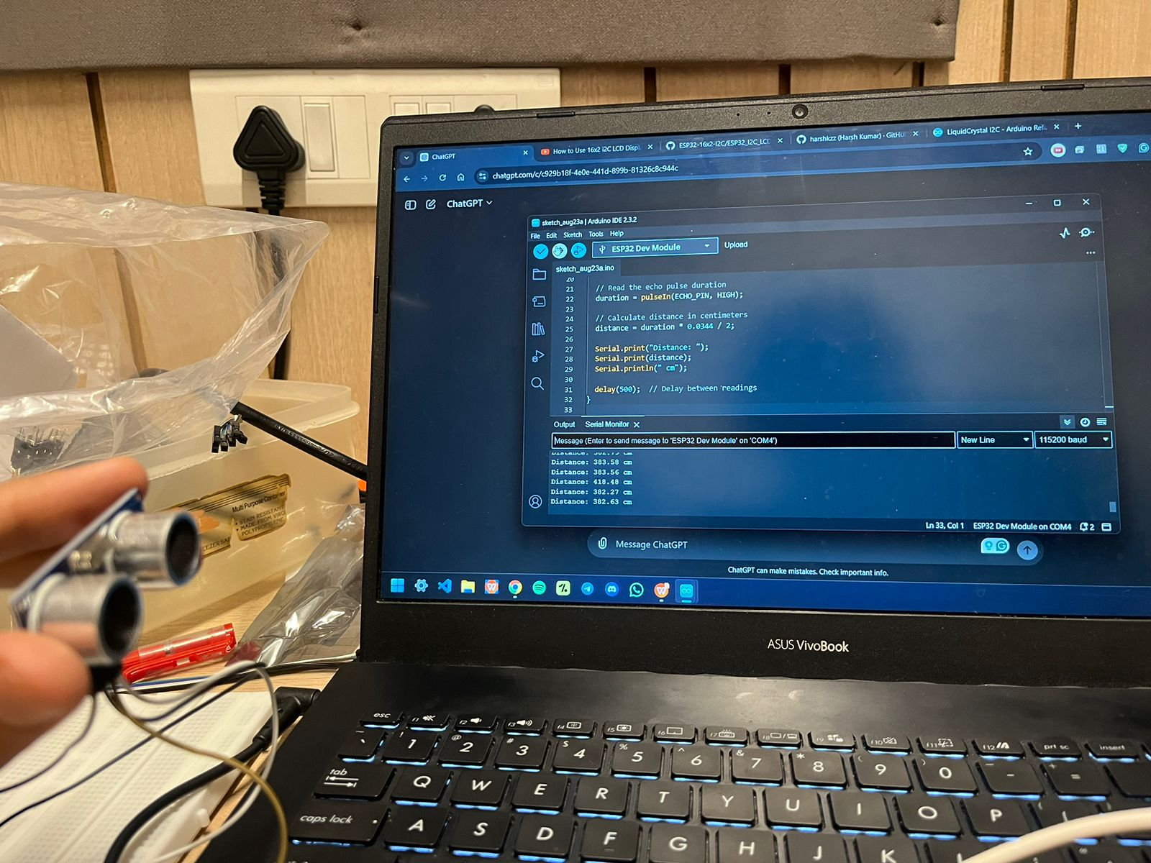
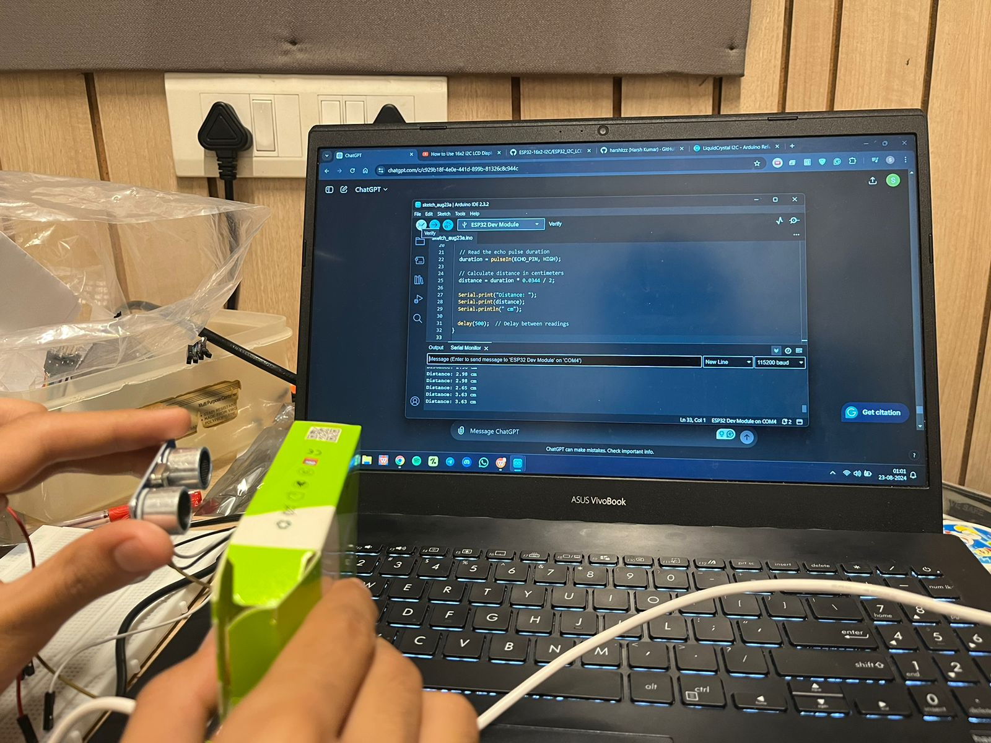
Current progress
Testing completed of individual components

Slide 16
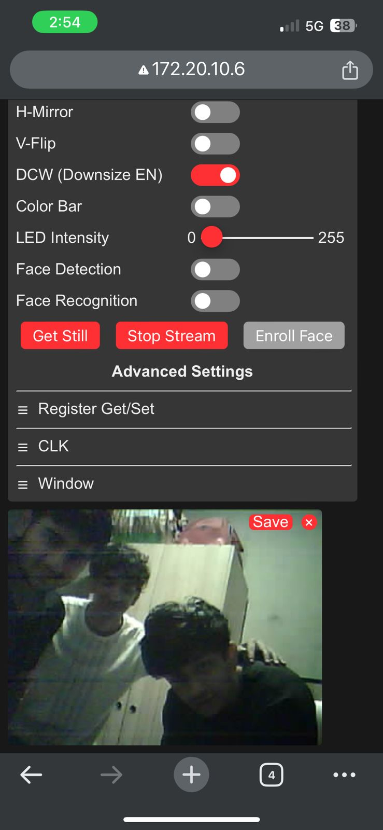
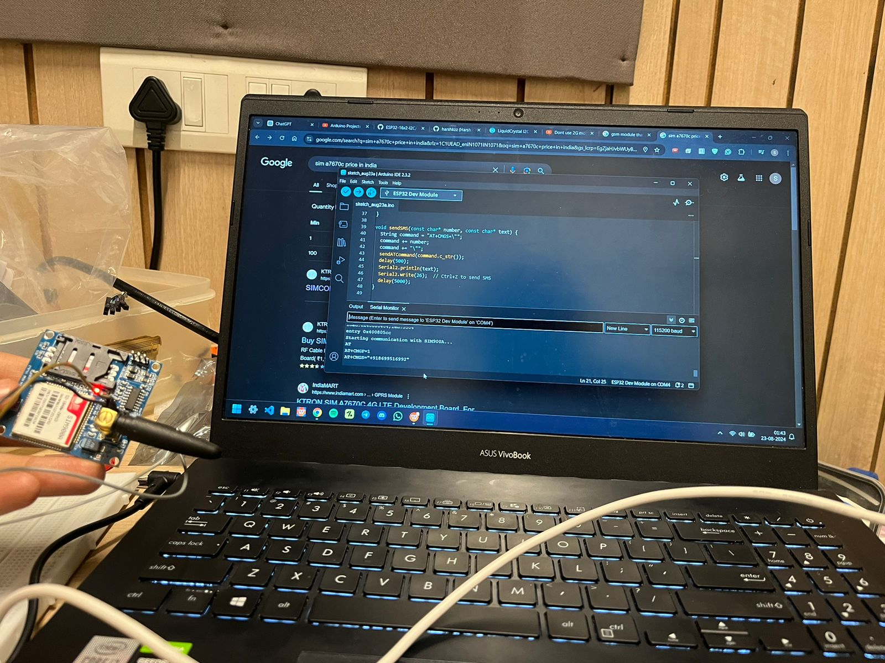
Current progress
Testing completed of individual components

Slide 17
Individual Contributions
SIDDHANT JAIN - Hardware
AMANPREET SINGH - Hardware
SAKSHAM MUTNEJA - Testing
SAMARTH THAKUR - Technical Report
SHIVAM GUPTA – Technical Report and Team Management

Slide 18
Future Work Plan
Design and Develop Smart Helmet Prototype: Design the physical structure of the smart helmet prototype to accommodate necessary sensors, communication modules, and and control components.
Implement Sensor Integration and Control System: Interface and integrate sensors (alcohol, IR, ultrasonic, accelerometer) with the Raspberry Pi microcontroller board.
Enhance Safety and Preventive Measures:
Implement algorithms to detect alcohol levels in the rider's breath using the alcohol sensor and disable bike ignition if intoxication is detected.
Develop logic to verify helmet usage through the IR sensor before allowing the bike to start, and provide audio and visual warnings if the helmet is not detected.
Integrate ultrasonic sensors to monitor distances from the front vehicle and trigger warnings/alerts if unsafe distances are detected, encouraging safe riding practices.
Enable Emergency Communication and Data Collection:
Integrate GPS and GSM modules to enable automatic SMS alerts with the rider's location to predefined emergency contacts in case of accidents or emergencies.

Slide 19
THANK YOU

